Slide 1
Setting the stage – Disclaimer
Presenter: Me; an analyst within the state health department.
Stakeholder: You; state health agency or board that has oversight of medical facilities within the state.
I am by no means an expert, and I have filled any gaps in this narrative that do not impact the intent of this project with fictional information. I understand that the purpose of this assignment is to exercise what we’ve learned about CRISP-DM and other concepts in this class, not to make me knowledgeable in a completely different subject. I have tried to be as factual as possible, but there will probably be several moments where someone who is proficient in any aspect of this scenario will have to suspend their disbelief. For example, this presentation is made in a scenario where:
We will ignore existing legality issues concerning the maintenance and upgrades of ventilators
We will pretend that the state medical system exists in a way that makes this project feasible

Slide 2
Sources
Google Brain - Ventilator Pressure Prediction | Kaggle
Respiratory Failure, RSI and Mechanical Ventilation Basics, a residency presentation by CPT Steven K. Sparks, M.D.
Patient Monitoring Alarms in an Intensive Care Unit: Observational Study With Do-It-Yourself Instructions - PubMed (nih.gov)
Alarms in a neurocritical care unit: a prospective study | SpringerLink
Alarm Fatigue: A Patient Safety Concern | Article | NursingCenter
Registered Nurse (RN) Hourly Pay in Maryland, Maryland | PayScale
Travel Nurse (RN) Hourly Pay | PayScale
High-Acuity Ventilator Cost Guide | Blog | HCP Resources | Medtronic
LSTM | Introduction to LSTM | Long Short Term Memory (analyticsvidhya.com)
Understanding 1D and 3D Convolution Neural Network | Keras | by Shiva Verma | Towards Data Science

Slide 3

Ventilator Type I errors
Presented by Mel Sparks

Slide 4
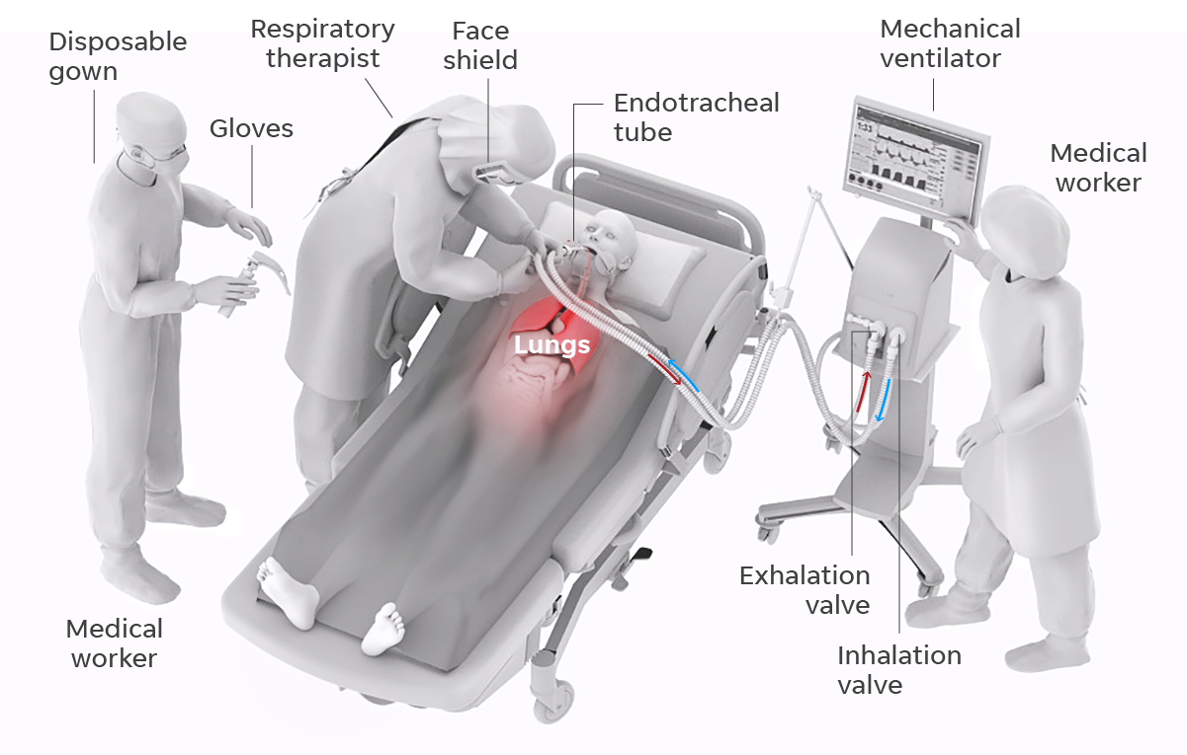
Business Problem
How can we reduce the time that healthcare workers spend attending to ventilator Type I errors?

Slide 5
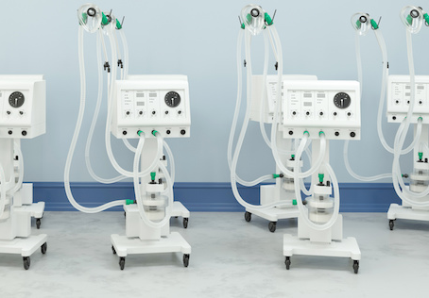
Business Problem (cont.)
Ventilators can be set to a specific volume or pressure (normally the latter, based off ideal bodyweight). When there is something wrong with a patient’s lungs (too much compliance or resistance) or if a patient’s oxygen stats fall below certain parameters, a ventilator’s alarm will sound.
Approximately 30.1 ventilator alarms per day
2.5-5 hours daily average per patient
72-99% of alarms are false
100% of alarms must be responded to

Slide 6
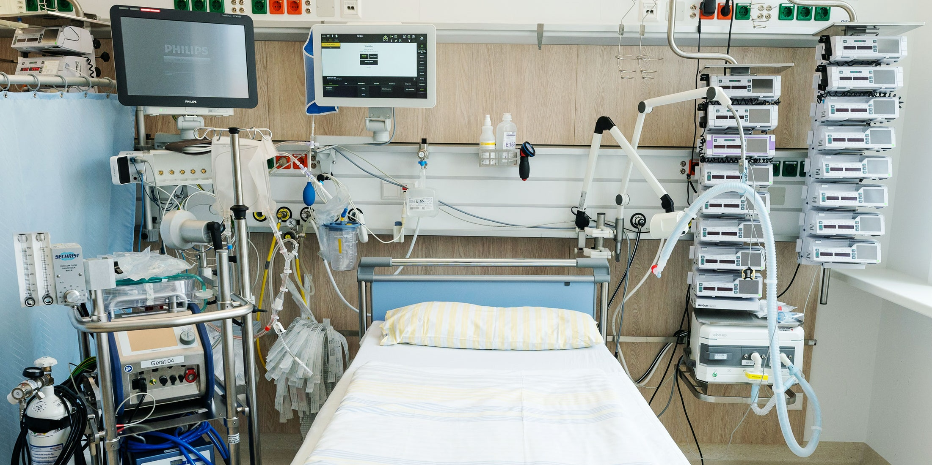
Business Problem (cont.)
If we can create a model that can better simulate the human lung with proper airway pressures, we can more accurately test new and improved ventilator machines and software before use on real patients.
This will ultimately result in better ventilators in operation at our facilities – ventilators with a reduced likelihood of Type I errors.

Slide 7
Data Understanding and Preparation
We are primarily concerned with emulating a patient’s inspiration vs expiration while on a ventilator.
The data we currently have has been provided by Princeton University and Google Brain.
We can also collect our own data from our own healthcare facilities.

Slide 8
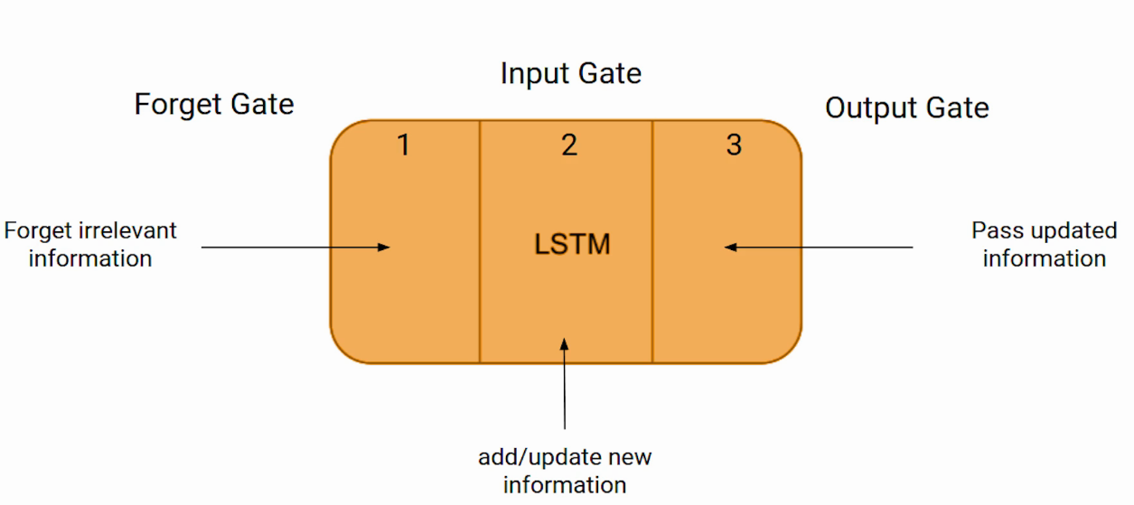
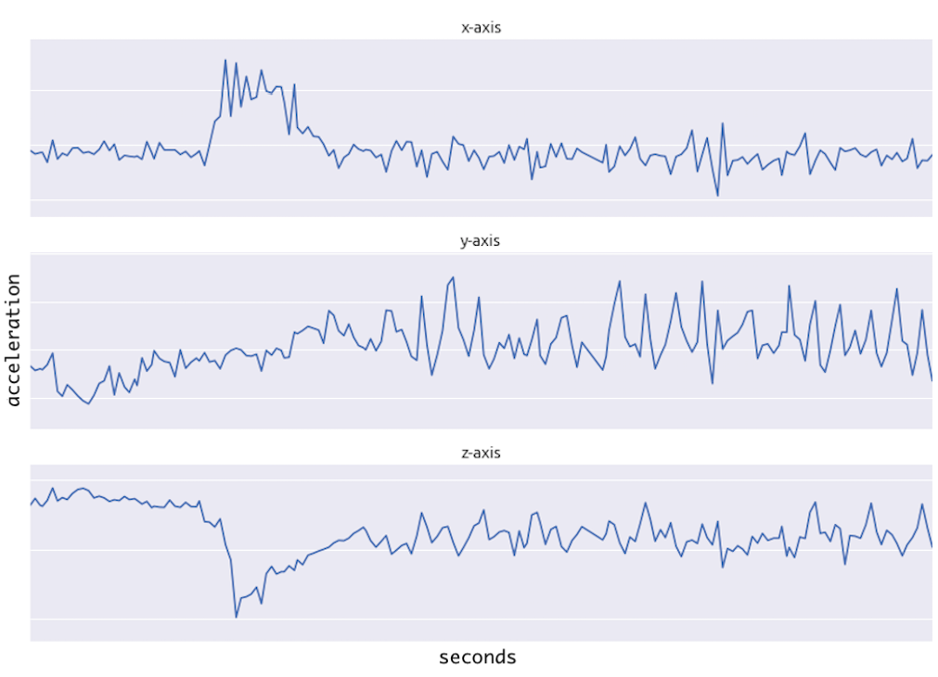
Model Selection
Neural Networks have seen success for these types of problems
LSTM
Conv1d

Slide 9
Evaluation
Validate Model
Real world data
Clinical trial

Slide 10
Deployment
Create simulated human lungs
1
Create new or modify existing ventilators
2
Acquire new ventilators or modify existing equipment in our facilities
3

Slide 11
Return on Investment
Amount of time practitioners spend on ventilator errors
Update ventilator software – no additional cost for new equipment
Nurse - $31.70 $587.93 per day $17,637.88 per month $214,594.21 per year
Travel Nurse - $36.37 $674.54 per day $20,236.27 per month $246,207.93 per year
30.9 72% 5 minutes

Slide 12
Return on Investment (cont.)
Buying new ventilators instead
10 Ventilators
$50k
$500k total
$2k annual
maintenance
Cost (measured in USD)
Time (measured in years)

